Slide 1

Hospital Project
Obstructive Sleep Apnea Syndrome:
4D CT analysis to access location and measurement of obstruction
Chiara Rossi
Deise Origuella

Slide 2
Overview
Pathology in Analysis
Clinical Problem and Request
Proposed Solution
Workflow:
Image processing - Segmentation and Registration
Centerline extraction and Cross-Section
Conclusions

Slide 3
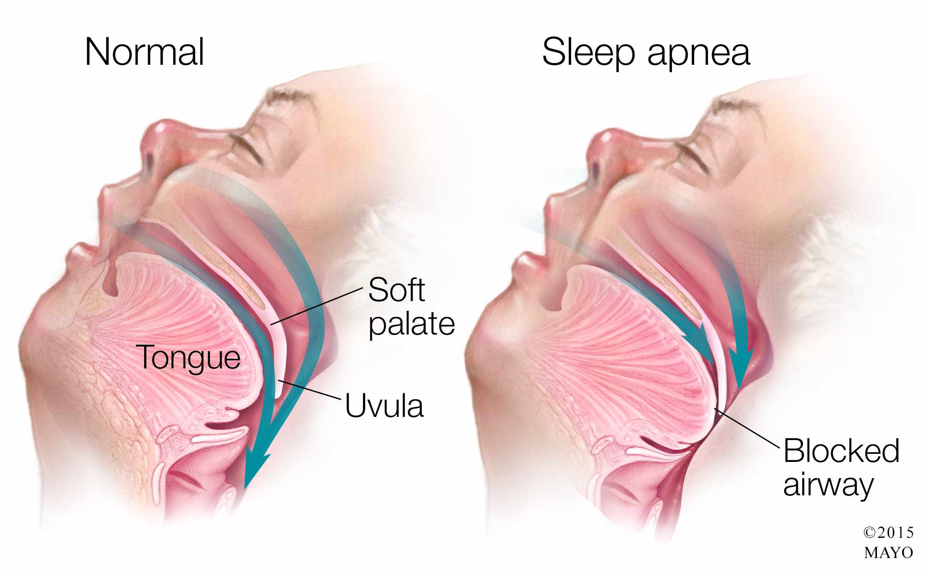
Obstructive Sleep Apnea Syndrome
WHAT? Occlusion of upper air pathways during sleep
HOW and WHERE? Throat divided into 3 regions, in each, collapsing of a different anatomical structure
can cause the obstruction:
Soft Palate
Tongue
Epiglottis
WHY? Muscles weakness
SYMPTOMS:
Loud snoring
Shortness of breath (at least 10 seconds)
Intermittent pauses in breathing during sleep
Excessive daytime drowsiness
2
1
3

Slide 4
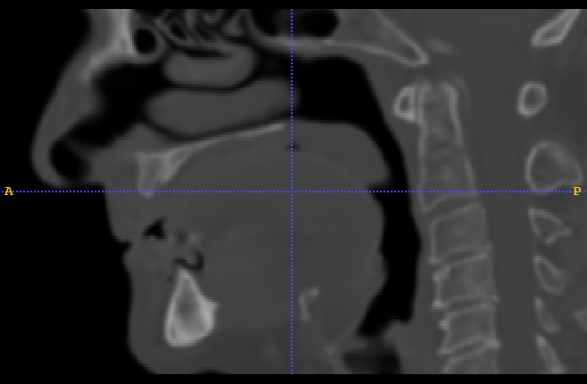
Clinical Problem - Request
Investigation Technique: 4D CT
DataSet
57 Patients
3 Sets/patient → Natural, Sleeping Apparatus (normal and max jaw’s pronation)
29 Scans/sets
Goals
Localization of Obstruction: 3 Regions Of Interest (ROIs)
Quantitative measurement of Degree of Obstruction
Request
Automatic Algorithm
Sistematic extraction of a quantity related to the obstuction
1
2
3

Slide 5
SWOT Analysis
INTERNAL FACTORS
STRENGTHS (+) | WEAKNESSES (–)
Background in Image processing | No healthy control subject
Easy format, opening with different programs | New programming languages
EXTERNAL FACTORS
OPPORTUNITIES (+) | THREATS (–)
Several available programs and tools to develop an algorithm | Lots of data
 | Employment of different libraries and image processing tools

Slide 6
Proposed Solution
Preprocessing
Development of an Atlas
Centerline of the Throat or Segmentation
Registration of the Atlas onto different Scans/Patients
Extraction of
Cross-Section
Obstruction

Slide 7
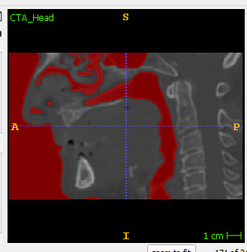
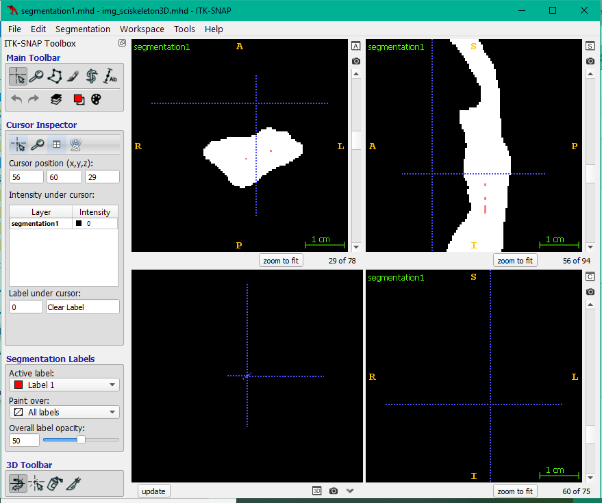
Workflow 1 - Preprocessing
Python - SimpleITK
Healthy subject CT: Reference Image
Pre-Processing : Otsu Filter
Segmentation: Region Growing (manually selected Seed)
Cropping Region of interest

Slide 8
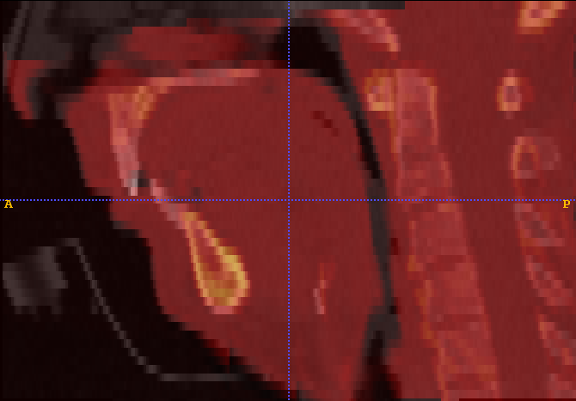
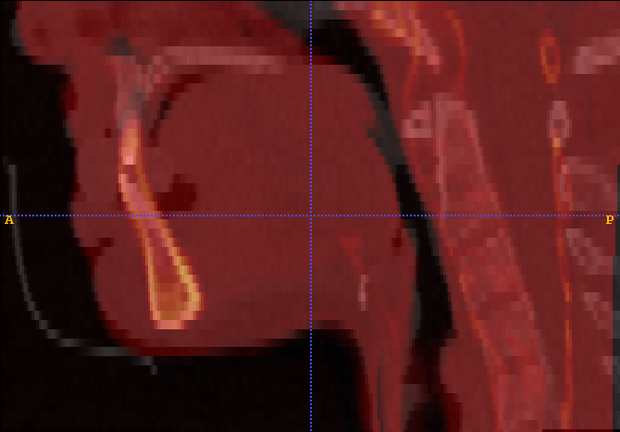
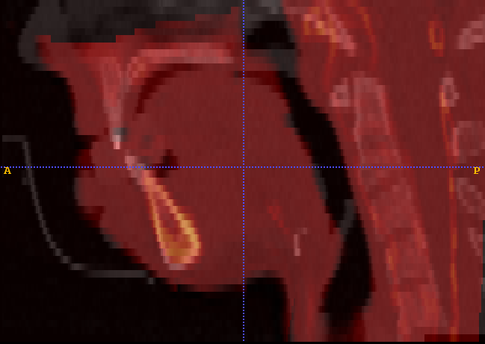
Registration
Elastix – 3 Steps
Pairwise registration between healthy patient and:
Patient without apparatus;
Patient with apparatus that maintains regular positioning of the jaw;
Patient with apparatus that brings the jaw to maximum pronation.

Slide 9
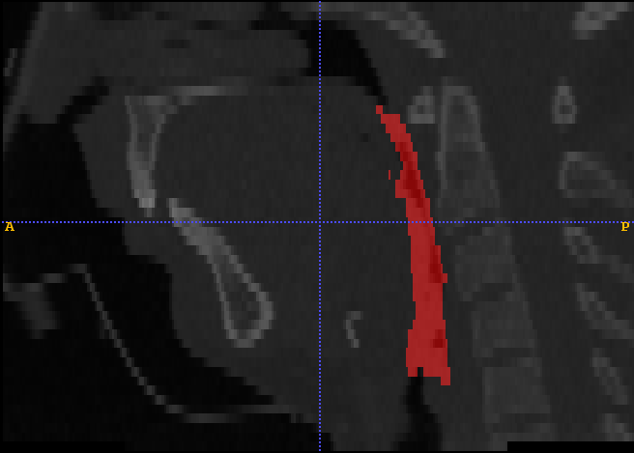
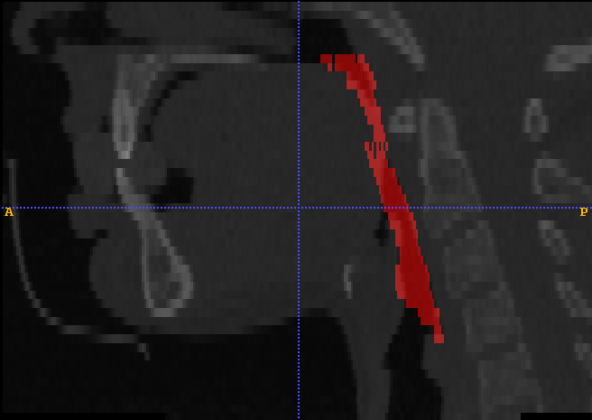
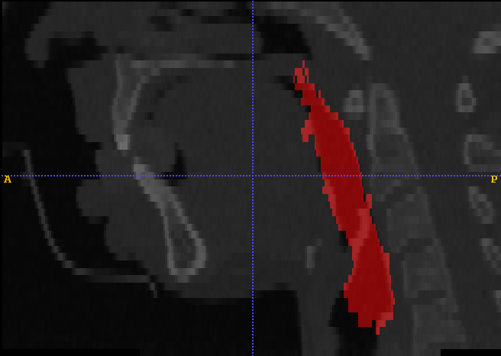
Transformation
Transformix
Applied on the binary segmentations from the three studied cases through output files from the registration step.

Slide 10
Proposed Solution
Preprocessing
Development of an Atlas
Centerline of the Throat or Segmentation
Registration of the Atlas onto different Scans/Patients
Extraction of
Cross-Section
Obstruction

Slide 11
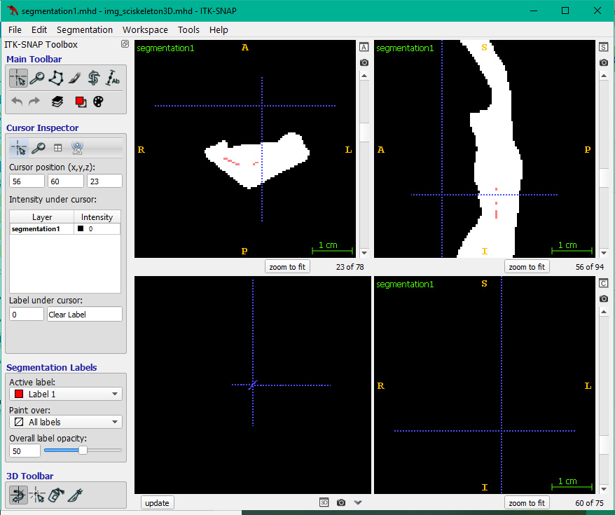
Workflow 2 – Centerline1
Extraction Centerline – Python
Problem: Skeletonization of Segmented region
3D → Library scikit-image : skeletonize_3D function
Report → All available and investigated approaches: VMTK, ITK filter, TubeTK etc..

Slide 12
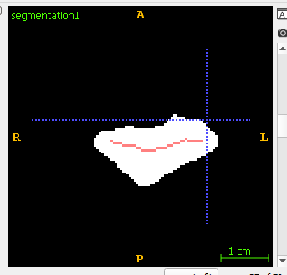
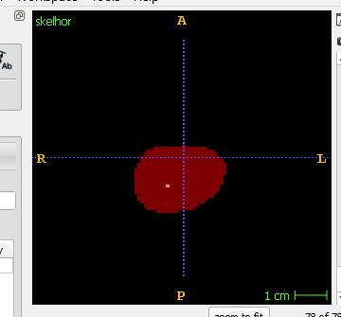
Workflow 2 – Centerline2
Extraction Centerline
Problem: Skeletonization of Segmented region
2D → Library scikit-image : skeletonize, middle_axis
1. Centerline in sagittal and horizontal plane → Multiplication
2. Centerline horizontal plane → Middle Point

Slide 13
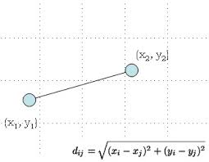
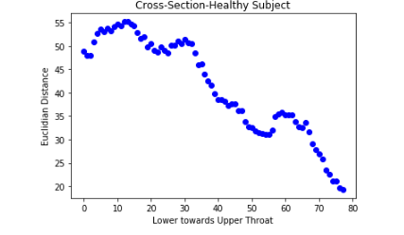
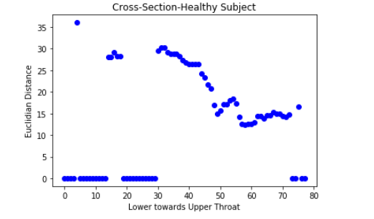
Workflow 3 – Cross Section
Steps:
Segmentation
Extraction ROI
Registration
Extraction Centerline
Cross-Section - Euclidian Distance
Results →
Point in ROI (x2, y2)
Point in Centerline (x1, y1)
2D
3D

Slide 14
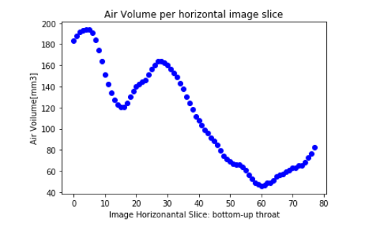
Workflow 4 – Volume extraction
Volume= number of voxel in ROI * Volume of single Voxel (voxel dimensions)
Steps:
Segmentation
Extraction ROI
Registration
Compute volume

Slide 15
Summary
Steps DONE:
Preprocessing and Segmentation
Registration
Extraction Centerline → Implementation of some approaches
Alternative approach: Volume extraction
Steps To DO:
Other alternative approaches to extract centerline and cross-sections (Report)
Implementation on patients dataset
Automatization of algorithm

Slide 16
Conclusions
Issues:
Each step is time consuming
Incompatibilities between libraries/tools
Non-automated process
Gained Knowledge:
Dealing with different tools and programming languages simultaneously
Application of theoretical knowledge
Approach a problem from different perspectives, looking for different solutions

Slide 17
Thank you!

